Slide 1

Neural Network distiller
A MODEL COMPRESSION RESEARCH LIBRARY
Neta Zmora
Principal Engineer, Intel AI Lab
See details and paper references in the Notes
Notes:
Resources:
Blog: https://ai.intel.com/compressing-deep-learning-models-with-neural-network-distiller
Documentation: https://nervanasystems.github.io/distiller/index.html
Github: https://github.com/NervanaSystems/distiller

Slide 2

About This Talk
z
Distiller
Deep NN Compression landscape
Terminology and concepts
A review of main research directions
Notes:
This presentation provides an overview of Distiller - a DNN compression research library, and surveys the DNN compression landscape to get familiarized with the terminology, concepts and main algorithm families.
This is a very high-level review of both Distiller and the DNN compression landscape, so many details are missing or might be summarized for the sake of brevity.
Included in the notes section, are references to important papers relevant to the slides.
Distiller resources:
Blog: https://ai.intel.com/compressing-deep-learning-models-with-neural-network-distiller
Documentation: https://nervanasystems.github.io/distiller/index.html
Github: https://github.com/NervanaSystems/distiller

Slide 3
Neural Network Distiller
An open-source Python package for neural network compression research.
Compression algorithms (pruning, regularization, quantization and more)
A set of analysis tools:
Gain insights into your model’s performance using interactive Jupyter Notebooks with Pandas DataFrames
Visualize training progress via TensorBoard integration
Example implementations of state-of-the-art compression papers
GitHub Repository
https://github.com/NervanaSystems/distiller
Notes:
Distiller is currently for inference research only!
Distiller is WiP -
This presentation covers some algorithms that are already implemented in Distiller, and some that may get implemented.
About Distiller:
Our goal is to try to implement many different types of compression schemes and to compare them on many different tasks (i.e. try out networks from different domains). This is motivated by:
Reproducing papers is the sound way to compare different compression methods so we strive to create a community of interested people to create a rich set of implemented (and scrutinize) algorithms
Once reproduced, different methods should be compared using the same datasets and architectures – and not necessarily the ones appearing in the original papers
This comparison should serve the rest of the community (researchers and practitioners), and us, to understand which are the best methods for the different tasks (and why so)
If researchers and practitioners adopt Distiller for their work, new compression methods will be readily reproducible and comparable
We will tune some methods specifically for Intel HW and SW, to show how specific HW and SW influences the configuration of the algorithms.

Slide 4
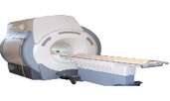
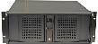



Cloud / Data Center
device
Compute Spectrum
Why we compress
Faster Smaller
heat & energy EFFICIENT
Increased throughput
Notes:
Before we start, let’s answer “why we compress”.
AI/DL is just making its way to many aspects of our lives and to every industry around us:
We want to run AI on Drones, smart glasses and smart sensors, VR
These environments are resource limited: e.g. storage and working memory, CPU, energy, bandwidth.
And in the cloud we are also concerned about power, latency and throughput.
Energy is a major component of TCO (Total Cost of Ownership)
Thermal – cooling requires space, infrastructure and energy
Latency sensitive app (e.g. real time language translation)
Throughput (e.g. video stream analysis)
In the foreseen future, applications will require more compute power as they evolve in “intelligence”. The forces above, together with increasing compute requirements, will keep us trying to make DNNs more efficient.

Slide 5
DL HW design
system SW and Dl frameworks
DNN Design & optimizations
SW-HW interface
Efficient inference
Faster Smaller
heat & energy EFFICIENT
Increased throughput
Notes:
Efficient Inference is all about making these things happen: Faster, smaller, energy-efficient and with more throughput.
EI encompasses several aspects, which are sometimes inter-related (e.g. HW-specifics can affect algorithm configuration and even the choice of the algorithm), but in this presentation we will cover only DNN Design & Optimizations.
Inference Latency grows with compute complexity ➔ affects realtime apps
Compute complexity is mainly in Conv layers
Params mostly in Linear layers (incl. RNNs)

Slide 6
DNN Design & optimizations
Efficient inference
Faster Smaller
heat & energy EFFICIENT
Increased throughput

Slide 7
DNN Design & Optimizations
(Taxonomy)
Architecture SEARCH
Neural Network compression
Redesign of Existing Networks
Our Journey
Manual
AutoML
Bayesian methods
Conditional computation
Low Rank Approximations
Automated Design-Space Exploration
Parameter pruning
Regularization
Low precision
Knowledge distillation
Notes:
We divide DNN Design & Optimizations to three categories of algorithm families.
Architecture Search – we will not cover in this presentation. It deals with a large topic of searching for efficient architectures. This category is related to the other two categories because the knowledge of what makes an architecture efficient, is also relevant to compression.
Manual architecture engineering - For example SqueezeNet, MobileNets (depth-wise separable convolutions, with depth control).
Of course, there are algorithmic interactions between these methods (reuse etc.).
In this presentation, we will go on a quick journey through the main algorithms in each of these algorithm families.

Slide 8
DNN Design & Optimizations
(Taxonomy)
Neural Network compression
Redesigning Existing Networks
Our Journey
Conditional computation
Low Rank Approximations
Automated Design-Space Exploration
Parameter pruning
Regularization
Low precision
Knowledge distillation
Notes:
We start with DNN Compression category, and with the family Parameter Pruning algorithms.
There is an interesting question: why do we even need compression? Why can’t we train DNNs with the exact capacity and generalization from the beginning?
This relates to AGP, ADC and the lottery ticket hypothesis

Slide 9
Parameter Pruning
What: inducing sparsity in a pre-trained model (make the model tensors have lots of zeros)
Why:
Compressed representation of zeros in parameter tensors
Less compute (sometimes)
Where: HW/SW platforms supporting sparse representations and compute
How: remove unimportant connections while preserving accuracy
Parameter
Pruning
Notes:
Pruning dates back at least to 1990 with LeCun’s OBD (Brain Damage)
Sparsity is a measure of the number of absolute zeros in a tensor. Inducing sparsity in the parameters means “creating” absolute zeros in our parameter tensors.
We won’t be talking about activation sparsity.
Pruning parameters and pruning neurons are closely related. The animation shows that the removal of all incoming (or outgoing) connections of a neuron, essentially removes that neuron.
An NN operation’s parameters are learned: weights and biases. We rarely prune biases, because biases are few and they have a large impact on the output.
“Connections” are the same as the weights, just a different name.
Removing connections means that they pass no information: both in the forward (removed connections are assigned a permanent value of zero) and backward (gradients do not flow through these connections) passes.

Slide 10
Parameter Pruning Flow
One-shot Pruning
Iterative Pruning
Pruning Criteria
Prune Connections
Pruning objective
accuracy
Pre-train: Learn connections
Evaluate connections importance
Remove least important connections
Fine Tune
Test
importance
pruning
Notes:
Two ways to think of Pruning ➔ finetuning:
Pruning damages the network, Fine Tuning then heals it
Pruning moves us away from the local minimum, Fine Tuning then moves us back to a same/different local minimum.
One-shot pruning rarely works because we are limited by the amount of damage we can do to the DNN, and still be able to recover.
Iterative pruning is like slowly transferring knowledge.
This is the main pruning pipeline flow. It is described in LeCun et al.’s Optimal Brain Damage paper from 1990, although in OBD this flow is not used.
In 2015 Song Han brings it back into main-stream fashion with his paper: Learning both Weights and Connections for Efficient Neural Networks
The cost function is not related to the pruning (chosen independently), unless we apply regularization (see later).
The Pruning Criteria is used to to evaluate which connections are important.
The pruning objective is used to decide when to stop (and later: how to prune).
This can be aided during training by applying L1 or L2 regularization, which will push unimportant kernels to have smaller values.
PRUNING CONVOLUTIONAL NEURAL NETWORKS FOR RESOURCE EFFICIENT INFERENCE
The proposed method for pruning consists of the following steps:
Fine-tune the network until convergence on the target task;
Alternate iterations of pruning and further fine-tuning;
Stop pruning after reaching the target trade-off between accuracy and pruning objective, e.g. floating point operations (FLOPs) or memory utilization.
Resources:
Optimal Brain Damage
Yann Le Cun , John S. Denker , Sara A. Solla
NIPS 1990
http://yann.lecun.com/exdb/publis/pdf/lecun-90b.pdf
Learning both Weights and Connections for Efficient Neural Networks
Song Han, Jeff Pool, John Tran, William J. Dally
2015
https://arxiv.org/abs/1506.02626
Pruning Convolutional Neural Networks for Resource Efficient Inference
Pavlo Molchanov, Stephen Tyree, Tero Karras, Timo Aila, Jan Kautz
ICLR 2017
https://arxiv.org/abs/1611.06440

Slide 11
Example: Magnitude Thresholding
Pruning Criteria
L₁(W) norm
Prune Connections
Sparsity level
accuracy
Pre-train: Learn connections
Sort parameters by their L1-norm
Threshold each tensor and apply
a mask
Fine Tune
Test
importance
pruning
Notes:
Intuition: small connection coefficients means small contribution to the logits of the layer.
Already this simple example shows us some of the challenges with this methodology: it is long, requires trial and error and has many new hyper-parameters (a threshold per layer).
Resources:
Optimal Brain Damage
Yann Le Cun , John S. Denker , Sara A. Solla
NIPS 1990
http://yann.lecun.com/exdb/publis/pdf/lecun-90b.pdf
Learning both Weights and Connections for Efficient Neural Networks
Song Han, Jeff Pool, John Tran, William J. Dally
2015
https://arxiv.org/abs/1506.02626

Slide 12
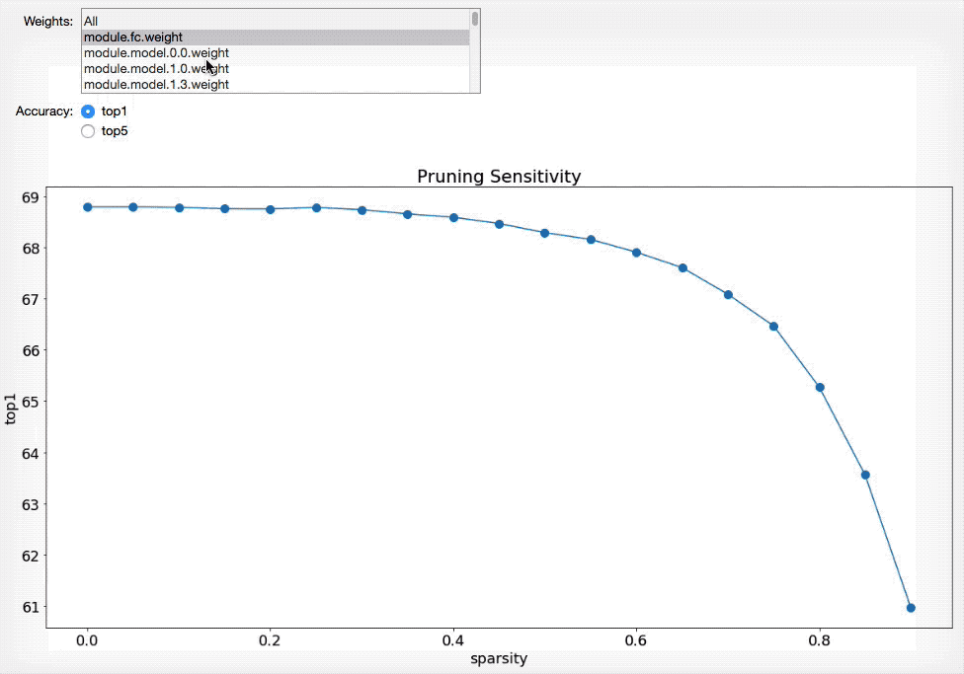
Sensitivity Analysis
We use sensitivity analysis to find thresholds or target compression rates for the layers
We prune each layer individually to discrete levels, and measure the accuracy loss
Does not measure dependencies between layers
https://github.com/NervanaSystems/distiller/blob/master/jupyter/sensitivity_analysis.ipynb
Notes:
Many hyper-parameters (even for a simple algorithm such as Magnitude Thresholding)
This makes pruning complex.
How do we decide on the threshold values?
Sensitivity analysis is a crude method to give us initial guesses at the threshold values.
The problem with SA is that it doesn’t consider the dependencies between the layers.
“We use sensitivity-based analysis to find a separate threshold for each layer” (from [1]).
Sensitivity Analysis “requires individually pruning every layer and measure the accuracy loss on the training dataset.” (from [2]).
Resources:
[1] Learning both Weights and Connections for Efficient Neural Networks
Song Han, Jeff Pool, John Tran, William J. Dally
2015
https://arxiv.org/abs/1506.02626
[2] Exploring the Regularity of Sparse Structure in Convolutional Neural Networks
Huizi Mao, Song Han, Jeff Pool, Wenshuo Li, Xingyu Liu, Yu Wang, William J. Dally
2017
https://arxiv.org/abs/1705.08922

Slide 13
Iterative Pruning Schedule
Algorithms are differentiated by schedules
What do you prune at each step?
All layers? Some layers? Specific channels? Do you order dynamically?...
How often do you prune?
Trade-off between training time and accuracy
Do you change pruning frequency?
E.g. Automated-gradual pruning (Zhu et. al 2017)
https://github.com/NervanaSystems/distiller/blob/master/jupyter/agp_schedule.ipynb
Notes:
“gradual network pruning inherits knowledge from the bigger and cumbersome network.” – from [5]
[1]: there are two strategies to solve this problem: prune once and retrain or prune and retrain iteratively
[6]: ”We demonstrate in our experiments that the former strategy (prune once) is not feasible since pruning too many layers may drop the accuracy significantly. Once the performance is heavily damaged, it cannot be regained by fine-tuning the pruned model.
The latter strategy, however, requires too many epochs to fine-tune the whole network, especially when the network is very deep.
(for filter pruning) [6]: “In this paper, we propose a novel learning schedule to trade-off between training speed and accuracy. Whenever one layer is pruned, the whole network is fine-tuned with one or two epochs to recover its performance slightly. Of course, this performance is not yet optimal, but is approaching to
it closely. Only after the final layer has been pruned, the network is fine-tuned carefully with many epochs. Using such a learning schedule, the overall training time can be reduced dramatically. But more importantly, this strategy would prevent the fine-tuned network from sinking into bad local minima in the early learning stage. Because the training
process of deep neural networks is a highly non-convex, if we always fine-tuned the network until convergence after pruning every layer, the network is likely to be attracted to a set of poor values in the early stage.”
[3]: “For all experiments we prune a single feature map at every pruning iteration, allowing fine-tuning and re-evaluation of the criterion to account for dependency between parameters”
[3]: “Varying the number of minibatch updates between pruning iterations with Fig. 6 shows pruning with the Taylor technique and a varying number of fine-tuning updates between pruning iterations. Increasing the number of updates results in higher accuracy, but at the cost of additional runtime of the pruning procedure. …
For a second experiment, we prune a trained VGG-16 network with the same parameters as before, except enabling FLOPs regularization. We stop pruning at two points, 11.5 and 8.0 GFLOPs, and fine-tune both models for an additional five epochs with learning rate 10−4 . Fine-tuning after pruning significantly improves results: the network pruned to 11.5 GFLOPs improves from 83% to 87% top-5 validation accuracy, and the network pruned to 8.0 GFLOPs improves from 77.8% to 84.5%.”
[4]: “We further propose a new CNN pruning algorithm with the goal to minimize overall energy consumption with marginal accuracy degradation. Unlike the previous pruning
methods, it directly minimizes the changes to the output feature maps as opposed to the changes to the filters and achieves a higher compression ratio (i.e ., the number of
removed weights divided by the number of total weights). With the ability to directly estimate the energy consumption of a CNN, the proposed pruning method identifies the parts
of a CNN where pruning can maximally reduce the energy cost, and prunes the weights more aggressively than previously proposed methods to maximize the energy reduction.
Fine grained method
In Step 1 , the pruning order of the layers is determined based on the energy as described in Sec. 2. Step 2, 3 and 4 removes, restores and locally fine-tunes weights, respectively,
for one layer in the network; this inner loop is repeated for each layer in the network”
Pruning by objective (guided pruning)
From [3]: “One of the main reasons to apply pruning is to reduce number of operations in the network. Feature maps from different layers require different amounts of computation due the number and sizes of input feature maps and convolution kernels.”
Resources:
[1] Pruning filters for efficient ConvNets.
H. Li, A. Kadav, I. Durdanovic, H. Samet, and H. P. Graf.
arXiv:1608.08710, 2016.
[2] To prune, or not to prune: exploring the efficacy of pruning for model compression
Michael Zhu, Suyog Gupta
2017
https://arxiv.org/abs/1710.01878
[3] Pruning Convolutional Neural Networks for Resource Efficient Inference
Pavlo Molchanov, Stephen Tyree, Tero Karras, Timo Aila, Jan Kautz
ICLR 2017
https://arxiv.org/abs/1611.06440
[4] Designing Energy-Efficient Convolutional Neural Networks using Energy-Aware Pruning
Tien-Ju Yang, Yu-Hsin Chen, Vivienne Sze
2016
https://arxiv.org/abs/1611.05128
[5] Structured Pruning of Deep Convolutional Neural Networks
Sajid Anwar, Kyuyeon Hwang, Wonyong Sung
2015
https://arxiv.org/abs/1512.08571
[6] An Entropy-based Pruning Method for CNN Compression
Jian-Hao Luo, Jianxin Wu
2016
https://arxiv.org/abs/1706.05791

Slide 14
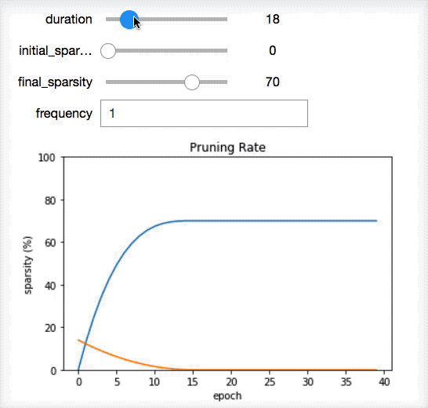
Iterative Pruning Schedule
Algorithms are differentiated by schedules
What do you prune at each step?
All layers? Some layers? Specific channels? Do you order dynamically?...
How often do you prune?
Trade-off between training time and accuracy
Do you change pruning frequency?
E.g. Automated-gradual pruning (Zhu et. al 2017)
https://github.com/NervanaSystems/distiller/blob/master/jupyter/agp_schedule.ipynb
Notes:
Like Learning Rate decay, we can use a mathematical formula to schedule the sparsity at each epoch.
AGP uses sparsity-level pruning in which at each pruning step the weights are pruned to a certain sparsity level. Instead of using thresholds as hyper-parameters (i.e. in Magnitude Threshold), AGP uses a few other parameters to create the schedule curve of the pruning process. Using sparsity-levels is easier than raw thresholds because the level does not depend on the distribution of the tensor. We can use the same pruner (i.e. set of AGP hyperparameters) on a group of several tensors, which reduces the number of hyperparameters we need to configure.
Resources:
[1] To prune, or not to prune: exploring the efficacy of pruning for model compression
Michael Zhu, Suyog Gupta
2017
https://arxiv.org/abs/1710.01878

Slide 15
Structured Pruning
Regularity (HW friendliness)
What: Prune groups of connections
Why: More compact sparse representation; faster inference (hit the vector compute sweet-spot)
Where:
Pruning filters/channels/layers creates small dense nets good for existing embedded devices
Others: require sparse-representation and sparsity-aware compute
What is the tradeoff between regularity and accuracy?^{[4]}
Source: Recent Advances in Efficient Computation of Deep Convolutional Neural Networks
Notes:
The terminology here might be confusing because sometimes we say that we prune feature-maps, and sometimes we say that we prune in/out parameter channels.
Regularity is HW specific but dense structure pruning is likely to speed up evaluation (inference) on embedded devices without customized optimization.
➔ prune entire feature maps
“Coarse-grained sparsity not only reduces the number of parameters but also constrains the positions of parameters, which is an even stronger regularizer.”
[4]: “Sparsity helps reducing the computation complexity of DNNs by skipping the multiplication with zeros. The granularity of sparsity affects the efficiency of hardware architecture and the prediction accuracy. In this paper we quantitatively measure the accuracy-sparsity relationship with different granularity. Coarse-grained sparsity brings more regular sparsity pattern, making it easier for hardware acceleration, and our experimental results show that coarsegrained sparsity have very small impact on the sparsity ratio given no loss of accuracy. Moreover, due to the index saving effect, coarse-grained sparsity is able to obtain similar or even better compression rates than fine-grained sparsity at the same accuracy threshold. Our analysis, which is based on the framework of a recent sparse convolutional neural network (SCNN) accelerator, further demonstrates that it saves 30%− 35% of memory references compared with fine-grained sparsity.”
[3]: Group-wise pruning (tiled sparsity) and compute using convolution lowering (im2col)
Resources:
[1] Block-Sparse Recurrent Neural Networks
Sharan Narang, Eric Undersander, Gregory Diamos
2017
https://arxiv.org/abs/1711.02782
[2] Recent Advances in Efficient Computation of Deep Convolutional Neural Networks
Jian Cheng, Peisong Wang, Gang Li, Qinghao Hu, Hanqing Lu
https://arxiv.org/abs/1802.00939
[3] Fast ConvNets Using Group-wise Brain Damage
Vadim Lebedev, Victor Lempitsky
https://arxiv.org/abs/1506.02515
[4] Exploring the regularity of sparse structure in convolutional neural networks
H Mao, S Han, J Pool, W Li, X Liu, Y Wang, WJ Dally.
arXiv:1705.08922, 2017
[5] Structured Pruning of Deep Convolutional Neural Networks
Sajid Anwar, Kyuyeon Hwang, Wonyong Sung
2015
https://arxiv.org/abs/1512.08571
[6] GPU Kernels for Block-Sparse Weights
Scott Gray, Alec Radford and Diederik P. Kingma
https://blog.openai.com/block-sparse-gpu-kernels/

Slide 16
Structured Pruning – Examples of Pruning Criteria
Structure
Magnitude
Loss/
Accuracy
L₁/L₂
Classification accuracy reduction (CAR)
APoZ
Activations
Explicit Objective
Entropy
Energy
Norm, Sparsity (APoZ)
Compute
Contribution (utilization)
Notes:
[5]:
• A greedy structural compression scheme that prunes filters in a trained CNN. We define a filter importance index equal to the classification accuracy reduction (CAR) of the network after pruning that filter (similarly defined as RAR for regression). We then iteratively prune filters based on the CAR index.
• this is the first reported result on the connection between compression and interpretability of CNNs: we demonstrate the interpretability of CAR-compressed CNNs by showing that our algorithm prunes filters with visually redundant functionalities
[4]: “We further propose a new CNN pruning algorithm with the goal to minimize overall energy consumption with marginal accuracy degradation. Unlike the previous pruning methods, it directly minimizes the changes to the output feature maps as opposed to the changes to the filters and achieves a higher compression ratio (i.e ., the number of removed weights divided by the number of total weights).
With the ability to directly estimate the energy consumption of a CNN, the proposed pruning method identifies the parts of a CNN where pruning can maximally reduce the energy cost, and prunes the weights more aggressively than previously proposed methods to maximize the energy reduction.
[3]:
• Filter pruning using activations
• Filter importance pruning criteria: entropy (information) -
“Our main insight is that, if the activation output of a specific filter contains less information, this filter seems less important, thus should be removed to get a small network. We propose an entropy-based channel selection metric to evaluate the importance of each filter, and prune several weak filters.
For a specific layer that we want to prune (i.e ., layer i), we first focus on its activation tensor. If several channels of its activation tensor are weak enough (e.g ., all elements have the same value), we have enough confidence to believe that the corresponding filters are also less important, which could be pruned. We proposed an entropy-based metric to evaluate the weakness of each channel.
In this paper, we propose an entropy-based metric to evaluate the importance of each filter. Entropy is a commonly used metric to measure the disorder or uncertainty in information
theory. A larger entropy value means the system contains more information. In our filter pruning scenario, if a channel of activation tensor contains less information, its corresponding filter is less important, thus could be dropped.”
[1]: Very cool paper and technique.
Add small layers that learn which filters to use per input sample, and then enforces that during inference (LKAM module).
“Past the end of the training phase, a simple statistical analysis of the kernel activations throughout
the dataset can reveal kernels with very low contribution, characterized by zero or near-zero
utilization. Such kernels can safely be considered redundant and pruned from the model along with
their corresponding filters in the LKA modules.”
Resources:
[1] Parsimonious Inference on Convolutional Neural Networks: Learning and applying on-line kernel activation rules
I. Theodorakopoulos, V. Pothos, D. Kastaniotis and N. Fragoulis1, Irida Labs S.A, January 2017
[2] Pruning filters for efficient ConvNets.
H. Li, A. Kadav, I. Durdanovic, H. Samet, and H. P. Graf.
arXiv:1608.08710, 2016.
[3] An Entropy-based Pruning Method for CNN Compression
Jian-Hao Luo, Jianxin Wu
2016
https://arxiv.org/abs/1706.05791
[4] Designing Energy-Efficient Convolutional Neural Networks using Energy-Aware Pruning
Tien-Ju Yang, Yu-Hsin Chen, Vivienne Sze
2016
https://arxiv.org/abs/1611.05128
[5] Structural Compression of Convolutional Neural Networks Based on Greedy Filter Pruning
Reza Abbasi-Asl, Bin Yu
2017
https://arxiv.org/abs/1705.07356

Slide 17
Distiller Architecture
Animation Hack
Designed to be easily integrated into your own PyTorch research applications
Add compression scheduling with only a few lines of code
Specify per-layer compression scheduling using a flexible and succinct syntax in YAML
Quickly extend with new algorithms
Leverage a rich set of application utilities
GitHub
Notes:
Distiller was designed to be familiar and immediately approachable so practitioners of PyTorch, so it has only a few abstractions.
Our goal is to simplify it further.

Slide 18
Distiller Architecture
Animation Hack
Designed to be easily integrated into your own PyTorch research applications
Add compression scheduling with only a few lines of code
Specify per-layer compression scheduling using a flexible and succinct syntax in YAML
Quickly extend with new algorithms
Leverage a rich set of application utilities
scheduler = distiller.file_config(model, optimizer, args.compress)
For each epoch:
scheduler.on_epoch_begin(epoch)
train():
For each mini_batch:
scheduler.on_minibatch_begin(epoch)
output = model(input_var)
loss = criterion(output, target_var)
scheduler.before_backward_pass(epoch)
loss.backward()
optimizer.step()
scheduler.on_minibatch_end(epoch)
validate()
save_checkpoint()
scheduler.on_epoch_end(epoch)
For each epoch:
train():
For each mini_batch:
output = model(input_var)
loss = criterion(output, target_var)
loss.backward()
optimizer.step()
validate()
save_checkpoint()
GitHub
Notes:
This is the canonical Pytorch training loop.
We sprinkle scheduler callbacks. The scheduler knows how to compress and when to compress.
Resources:
see https://nervanasystems.github.io/distiller/schedule/index.html

Slide 19
Distiller Architecture
Animation Hack
pruners:
pruner1:
class: 'SensitivityPruner'
sensitivities:
'features.module.0.weight': 0.25
'features.module.3.weight': 0.35
'features.module.6.weight': 0.40
'features.module.8.weight': 0.45
'features.module.10.weight': 0.55
'classifier.1.weight': 0.875
'classifier.4.weight': 0.875
'classifier.6.weight': 0.625
lr_schedulers:
pruning_lr:
class: ExponentialLR
gamma: 0.9
policies:
- pruner:
instance_name : 'pruner1'
starting_epoch: 0
ending_epoch: 38
frequency: 2
- lr_scheduler:
instance_name: pruning_lr
starting_epoch: 24
ending_epoch: 200
frequency: 1
pruners:
pruner1:
class: 'SensitivityPruner'
sensitivities:
'features.module.0.weight': 0.25
'features.module.3.weight': 0.35
'features.module.6.weight': 0.40
'features.module.8.weight': 0.45
'features.module.10.weight': 0.55
'classifier.1.weight': 0.875
'classifier.4.weight': 0.875
'classifier.6.weight': 0.625
lr_schedulers:
pruning_lr:
class: ExponentialLR
gamma: 0.9
policies:
- pruner:
instance_name : 'pruner1'
starting_epoch: 0
ending_epoch: 38
frequency: 2
- lr_scheduler:
instance_name: pruning_lr
starting_epoch: 24
ending_epoch: 200
frequency: 1
pruners:
pruner1:
class: 'SensitivityPruner'
sensitivities:
'features.module.0.weight': 0.25
'features.module.3.weight': 0.35
'features.module.6.weight': 0.40
'features.module.8.weight': 0.45
'features.module.10.weight': 0.55
'classifier.1.weight': 0.875
'classifier.4.weight': 0.875
'classifier.6.weight': 0.625
lr_schedulers:
pruning_lr:
class: ExponentialLR
gamma: 0.9
policies:
- pruner:
instance_name : 'pruner1'
starting_epoch: 0
ending_epoch: 38
frequency: 2
- lr_scheduler:
instance_name: pruning_lr
starting_epoch: 24
ending_epoch: 200
frequency: 1
Designed to be easily integrated into your own PyTorch research applications
Add compression scheduling with only a few lines of code
Specify per-layer compression schedule using a flexible and succinct syntax in YAML
Quickly extend with new algorithms
Leverage a rich set of application utilities
pruners:
pruner1:
class: 'SensitivityPruner'
sensitivities:
'features.module.0.weight': 0.25
'features.module.3.weight': 0.35
'features.module.6.weight': 0.40
'features.module.8.weight': 0.45
'features.module.10.weight': 0.55
'classifier.1.weight': 0.875
'classifier.4.weight': 0.875
'classifier.6.weight': 0.625
lr_schedulers:
pruning_lr:
class: ExponentialLR
gamma: 0.9
policies:
- pruner:
instance_name : 'pruner1'
starting_epoch: 0
ending_epoch: 38
frequency: 2
- lr_scheduler:
instance_name: pruning_lr
starting_epoch: 24
ending_epoch: 200
frequency: 1
pruners:
pruner1:
class: 'SensitivityPruner'
sensitivities:
'features.module.0.weight': 0.25
'features.module.3.weight': 0.35
'features.module.6.weight': 0.40
'features.module.8.weight': 0.45
'features.module.10.weight': 0.55
'classifier.1.weight': 0.875
'classifier.4.weight': 0.875
'classifier.6.weight': 0.625
lr_schedulers:
pruning_lr:
class: ExponentialLR
gamma: 0.9
policies:
- pruner:
instance_name : 'pruner1'
starting_epoch: 0
ending_epoch: 38
frequency: 2
- lr_scheduler:
instance_name: pruning_lr
starting_epoch: 24
ending_epoch: 200
frequency: 1
For each epoch:
train():
For each mini_batch:
output = model(input_var)
loss = criterion(output, target_var)
loss.backward()
optimizer.step()
validate()
save_checkpoint()
scheduler = distiller.file_config(model, optimizer, args.compress)
For each epoch:
scheduler.on_epoch_begin(epoch)
train():
For each mini_batch:
scheduler.on_minibatch_begin(epoch)
output = model(input_var)
loss = criterion(output, target_var)
scheduler.before_backward_pass(epoch)
loss.backward()
optimizer.step()
scheduler.on_minibatch_end(epoch)
validate()
save_checkpoint()
scheduler.on_epoch_end(epoch)
GitHub
Notes:
The scheduler learns about the algorithms, their arguments and the schedule from a configuration structure, that can be read from a YAML file.
The YAML file decouples the application from the algorithm, so you can try several algorithms and schedules on the same application.

Slide 20
Distiller Architecture
Animation Hack
Designed to be easily integrated into your own PyTorch research applications
Add compression scheduling with only a few lines of code
Specify per-layer compression scheduling using a flexible and succinct syntax in YAML
Quickly extend with new algorithms
Leverage a rich set of application utilities
GitHub

Slide 21
DNN Design & Optimizations
(Taxonomy)
Neural Network compression
Redesigning Existing Networks
Our Journey
Conditional computation
Low Rank Approximations
Automated Design-Space Exploration
Parameter pruning
Regularization
Low precision
Knowledge distillation

Slide 22
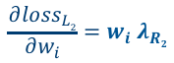
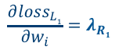
Sparsity-inducing Regularization
“Toy” loss function
What: Induce sparsity by penalizing weight sizes while training
Why:
Faster than pruning: performed during the training process
At low strengths, it can reduce overfitting (decrease the generalization error)
When: as in fine-grain and structured pruning
How:
$$\frac{∂{loss}_{L1}}{∂w_{i}}=λ_{R1}$$
$$\frac{∂{loss}_{L2}}{∂w_{i}}={w_{i} λ}_{R2}$$
$${loss\left(data, W\right)= loss}_{objective}\left(data, W\right)+ λ_{R2}{\left\|W\right\|}_{2}^{2}+ λ_{R1}{\left\|W\right\|}_{1}$$
Contour diagram
Notes:
Contour diagram created in Distiller’s Jupyter notebook: https://github.com/NervanaSystems/distiller/blob/master/jupyter/L1-regularization.ipynb
The formula in the “How” section is actually an Elastic Net.

Slide 23
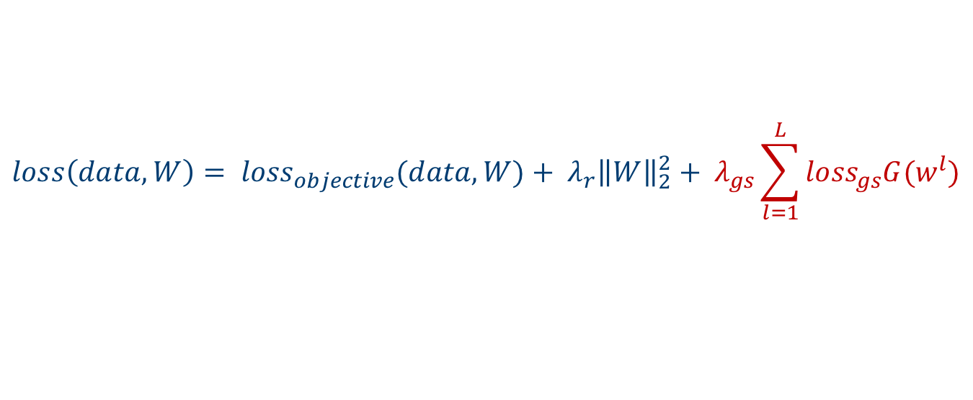
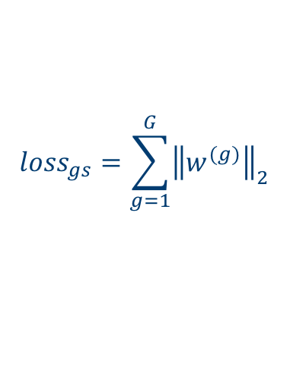
Group Sparsity Regularization
regularizers:
Channels_groups_regularizer:
class: GroupLassoRegularizer
reg_regims:
module.layer1.0.conv2.weight: [0.0008, Channels]
module.layer1.1.conv2.weight: [0.0008, Channels]
module.layer1.2.conv2.weight: [0.0008, Channels]
module.layer2.0.conv2.weight: [0.0008, Channels]
module.layer2.1.conv2.weight: [0.0008, Channels]
module.layer2.1.conv2.weight: [0.0008, Channels]
module.layer3.0.conv2.weight: [0.0008, Channels]
module.layer3.1.conv2.weight: [0.0008, Channels]
module.layer3.1.conv2.weight: [0.0008, Channels]
threshold_criteria: Mean_Abs
policies:
- regularizer:
instance_name: Channels_groups_regularizer
args:
keep_mask: True
starting_epoch: 0
ending_epoch: 180
frequency: 1
Group sparsity is very beneficial for reducing computation complexity and parameter sizes.
We can group connections in various structures – just like in group pruning
$${loss\left(data, W\right)= loss}_{objective}(data, W)+ λ_{r}{\left\|W\right\|}_{2}^{2}+ λ_{gs}\sum_{l=1}^{L}{{{loss}_{gs}G(w}^{l})}$$
$${loss}_{gs}=\sum_{g=1}^{G}{{\left\|w^{(g)}\right\|}_{2}}$$
Sometimes other objectives are used for regularization
Notes:
Sparse Group Lasso regularization, and a sample YAML schedule file.

Slide 24
DNN Design & Optimizations
(Taxonomy)
Neural Network compression
Redesigning Existing Networks
Our Journey
Conditional computation
Low Rank Approximations
Automated Design-Space Exploration
Parameter pruning
Regularization
Low precision
Knowledge distillation

Slide 25
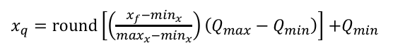
Low Precision (Quantization)
$x_{q}=round\left[\left(\frac{x_{f}−\min_{x}}{\max_{x}−\min_{x}}\right)\left(Q_{max}−Q_{min}\right)\right]$ $+Q_{min}$
What:
Use lower-precision numerical formats to represent tensors
Replace FP32 operations (convs, gemm, activations, etc.) with low-precision operations (e.g. INT8)
Why: Storage and work memory, throughput, power, speed; use on embedded devices w/o FP support
Where: the HW or SW supports low-precision NN operations
How:
Quantize Tensor: Clip → Scale → Discretize → Shift
Quantize Model: Single-shot quantization / Iterative quantization / Quantization-aware training
FP32 (x_{f})
INT8 (x_{q})
Q_{max}
max_{x}
± 3.4e38 dynamic range
0
0..255
min_{x}
Q_{min}
Notes:
Quantization is a sophisticated rounding function: The trick is not to accumulate errors despite the many multiplications and additions
Quantizing is like projecting a “continuous” high-precision space to a discreet, finite space
^{[1]} https://lemire.me/blog/2017/02/28/how-many-floating-point-numbers-are-in-the-interval-01/
Another reason to quantize is to reduce the computational resources you need to do the inference calculations, by running them entirely with eight-bit inputs and outputs. This is a lot more difficult since it requires changes everywhere you do calculations, but offers a lot of potential rewards. Fetching eight-bit values only requires 25% of the memory bandwidth of floats, so you’ll make much better use of caches and avoid bottlenecking on RAM access. You can also typically use SIMD operations that do many more operations per clock cycle.
Need to make sure accumulation of low precision numbers does not overflow, by allocating enough bits in the accumulator
Challenges:
Mixed precision models might be required
Integration
Quantize tensor:
This is “basic” linear quantization – more complex methods inc. non-linear quantization exist
Clip and Shift are optional.
Clip – to remove outliers. Can get by without clipping in some 8-bit scenarios, must clip < 8-bits. Clipping methods:
Using statistics (percentiles)
Using information-loss criteria (e.g. KL-Divergence)
Using pre-defined value
Learn clip value (in quantization-aware training setting)
Quantize model:
Single-shot: Good enough for INT8 in many cases (but not all!). Doesn’t work < 8-bits for anything but the most trivial models.
Quantization-aware training: Simulate quantization during training, so optimizer sees effects of quantization
Iterative – Not supported in Distiller yet:
1. Quantize some weights according to some criteria
2. Fine-tune
3. Back to 1 (until all weights quantized)

Slide 26
Adding Quantization to an Inference Graph
x
w
x
w
x
w
Quantize
Quantize
Quantize
Quantize
QuantizedOp1
Op1
QuantizedOp1
Op1
De-Quantize
De-Quantize
Insert quantization ops
Quantize
Remove redundant ops
Quantize
Op2
QuantizedOp2
Op2
QuantizedOp2
y
De-Quantize
De-Quantize
FP32
Low Precision
y
y
Notes:
The exact graph transform might vary based on the actual quantization method and the availability of quantized operations. In Distiller each quantization method defines the transformations it requires (e.g. replace conv2d with q_conv2d). Once defined, that method can be applied to any model automatically.
Re-scaling: Inputs, weights and output of an op will most likely have different distributions and hence different scales. The scales must be matched (normalized) for the quantized op to be correct. This is commonly called “re-scaling”. This might happen before or after the actual quantized op – depends on the operation itself. If after, then it’s actually the accumulator that is re-scaled, not the inputs/weights. Bias isn’t shown here but of course the same applies.

Slide 27
DNN Design & Optimizations
(Taxonomy)
Neural Network compression
Redesigning Existing Networks
Our Journey
Conditional computation
Low Rank Approximations
Automated Design-Space Exploration
Parameter pruning
Regularization
Low precision
Knowledge distillation

Slide 28
Knowledge Distillation
What: transfer knowledge from a complex model (teacher) to a simpler model (student)
Why: Reduced compute complexity
Where: HW/SW agnostic
How: Learn a large complex model and train a more compact DNN to reproduce its output
Distillation and quantization, pruning, or regularization can be used together
Notes:
Knowledge distillation can be regarded as a kind of transfer learning, which aims to transform the knowledge learned by a cumbersome model to a simple model. The original cumbersome model plays the role of a teacher, and a small model is trained to mimic the performance of the teacher. With the guidance from the teacher model, the student model can even outperform this teacher [27]
Resources:
Distilling the Knowledge in a Neural Network
Geoffrey Hinton, Oriol Vinyals, Jeff Dean
https://arxiv.org/abs/1503.02531v1 - 2015
Model compression via distillation and quantization
Antonio Polino, Razvan Pascanu, Dan Alistarh
https://openreview.net/forum?id=S1XolQbRW
https://blog.twitter.com/engineering/en_us/topics/infrastructure/2018/Smart-Auto-Cropping-of-Images.html Faster gaze prediction with dense networks and Fisher pruning
Lucas Theis, Iryna Korshunova, Alykhan Tejani, Ferenc Huszár
https://arxiv.org/abs/1801.05787
Apprentice: Using Knowledge Distillation Techniques To Improve Low-Precision Network Accuracy
Asit Mishra, Debbie Marr
https://openreview.net/forum?id=B1ae1lZRb

Slide 29
DNN Design & Optimizations
(Taxonomy)
Neural Network compression
Redesigning Existing Networks
Our Journey
Conditional computation
Low Rank Approximations
Automated Design-Space Exploration
Parameter pruning
Regularization
Low precision
Knowledge distillation

Slide 30
Conditional Computation
What: Change the architecture so that each input sample uses different parts of the network
Why: Reduce the average compute time
When: batch-1 realtime applications
How:
Early Exit: early layers may have enough knowledge to classify ➔ so exit early
Network selection: learn a network selection system that adaptively selects the network to be evaluated for each example
Source: BranchyNet, Teerapittayanon
et al. 2017
Notes:
Resources:
BranchyNet: Fast Inference via Early Exiting from Deep Neural Networks
Surat Teerapittayanon, Bradley McDanel, H.T. Kung
https://arxiv.org/abs/1709.01686
Better suited for batch-1 realtime applications
Adaptive Neural Networks for Efficient Inference
Tolga Bolukbasi, Joseph Wang, Ofer Dekel, Venkatesh Saligrama ;
Proceedings of the 34th International Conference on Machine Learning, PMLR 70:527-536, 2017.
http://proceedings.mlr.press/v70/bolukbasi17a/bolukbasi17a.pdf
Outrageously Large Neural Networks: The Sparsely-Gated Mixture-of-Experts Layer
https://arxiv.org/abs/1701.06538
Multi-Scale Dense Networks for Resource Efficient Image Classification
Gao Huang, Danlu Chen, Tianhong Li, Felix Wu, Laurens van der Maaten, Kilian Q. Weinberger
Parsimonious Inference on Convolutional Neural Networks: Learning and applying on-line kernel activation rules
I. Theodorakopoulos, V. Pothos, D. Kastaniotis and N. Fragoulis1, Irida Labs S.A, January 2017
Very cool paper and technique.
Add small layers that learn which filters to use per input sample, and then enforce that during inference (LKAM module).

Slide 31
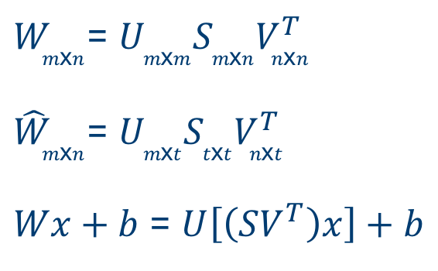
Approximating Existing Networks (low rank decomposition)
What: Decompose NN operations into smaller, but approximate, operations
Why: We end up with dense compute of several smaller convolutions (reduced compute)
Where: when its efficient to execute small dense NN operations
How: Truncated SVD, spatial and channel decomposition, Tucker-decomposition, Kronecker products, CP-decomposition
Truncated SVD
$W_{m\text{x}n}$= $U_{m\text{x}m}S_{m\text{x}n}V_{n\text{x}n}^{T}$
${\hat{W}}_{m\text{x}n}$= $U_{m\text{x}t}S_{t\text{x}t}V_{n\text{x}t}^{T}$
$Wx+b$ = $U\left[\left(SV^{T}\right)x\right]+b$
Notes:
“The motivation behind low-rank decomposition is to find an approximate tensor ^W that is close to W but facilitates more efficient computation.”
We end up with a dense computation.
The flow is similar to pruning: decompose – finetune (rinse/repeat).
SVD = Singular Value Decomposition
Truncated SVD: after singular value decomposition take the largest t singular values and zero out the rest.
“Truncated SVD reduces the parameter count from mn to t(m + n), which can be significant if t is much smaller than min(m, n).”
FC: m*n MACs vs. (t * n + m * t) MACs
[9]: “Low-rank factorization based techniques use matrix/tensor decomposition to estimate the informative parameters of the deep CNNs.”
[10]: “Low rank matrix approximations (factorization) are a well-established mathematical minimization problem where the cost function is the fit between a given matrix and an approximating matrix under the constraint that it has a reduced rank. This is successfully used in a variety of applications. Generalized as a tensor decomposition the approximation form a non-convex optimization problem and is in general difficult to compute (Tai, 2015). ”
Resources:
[1] Speeding-up Convolutional Neural Networks Using Fine-tuned CP-Decomposition
Vadim Lebedev, Yaroslav Ganin, Maksim Rakhuba, Ivan Oseledets, Victor Lempitsky
https://arxiv.org/abs/1412.6553
We propose a simple two-step approach for speeding up convolution layers within large convolutional neural networks based on tensor decomposition and discriminative fine-tuning. Given a layer, we use non-linear least squares to compute a low-rank CP-decomposition of the 4D convolution kernel tensor into a sum of a small number of rank-one tensors. At the second step, this decomposition is used to replace the original convolutional layer with a sequence of four convolutional layers with small kernels. After such replacement, the entire network is fine-tuned on the training data using standard backpropagation process.
[2] Speeding up Convolutional Neural Networks with Low Rank Expansions
Max Jaderberg, Andrea Vedaldi, Andrew Zisserman
https://arxiv.org/abs/1405.3866
In this work we present two simple schemes for drastically speeding up these layers. This is achieved by exploiting cross-channel or filter redundancy to construct a low rank basis of filters that are rank-1 in the spatial domain. Our methods are architecture agnostic, and can be easily applied to existing CPU and GPU convolutional frameworks for tuneable speedup performance.
==> Two variaitions of Spatial Decompostion
[3] Accelerating Very Deep Convolutional Networks for Classification and Detection
Xiangyu Zhang, Jianhua Zou, Kaiming He, Jian Sun
https://arxiv.org/abs/1505.06798
==> Channel Decomposition
[4] Accelerating Convolutional Neural Networks for Mobile Applications
https://dl.acm.org/citation.cfm?id=2967280
==>Block Term Decomposition – low-rank and group sparse decomposition
[5] Exploiting Linear Structure Within Convolutional Networks for Efficient Evaluation
Emily Denton, Wojciech Zaremba, Joan Bruna, Yann LeCun, Rob Fergus
[6] Exploiting Local Structures with the Kronecker Layer in Convolutional Networks
Shuchang Zhou, Jia-Nan Wu, Yuxin Wu, Xinyu Zhou
[7] Compression of Deep Convolutional Neural Networks for Fast and Low Power Mobile Applications
Yong-Deok Kim, Eunhyeok Park, Sungjoo Yoo, Taelim Choi, Lu Yang, Dongjun Shin
https://arxiv.org/abs/1511.06530
The proposed scheme consists of three steps: (1) rank selection with variational Bayesian matrix factorization, (2) Tucker decomposition on kernel tensor, and (3) fine-tuning to recover accumulated loss of accuracy
[8] Fast R-CNN
Ross Girshick
https://arxiv.org/abs/1504.08083
[9] A Survey of Model Compression and Acceleration for Deep Neural Networks
Yu Cheng, Duo Wang, Pan Zhou, Tao Zhang
2017
https://arxiv.org/abs/1710.09282
[10] Establishing Effective Techniques for Increasing Deep Neural Networks Inference Speed
ALBIN SUNESSON
http://www.nada.kth.se/~ann/exjobb/albin_sunesson.pdf
[11] Low-Rank Tensor Decomposition via Multiple Reshaping and Reordering Operations
Chao Li, Mohammad Emtiyaz Khan, Shengli Xie, Qibin Zhao
https://arxiv.org/pdf/1805.08465.pdf
http://langvillea.people.cofc.edu/DISSECTION-LAB/Emmie%27sLSI-SVDModule/p5module.html
https://towardsdatascience.com/speeding-up-convolutional-neural-networks-240beac5e30f

Slide 32
Automated Design-Space Exploration
The ”entire” design space
What: Search in a subspace of the design space, defined by transformations on a given network (e.g. subtraction)
Why: to automate and speed-up the compression process ➔ scale
Where: creates dense operations that can be used everywhere
How:
Use a Reinforcement Learning agent to search the architecture sub-space defined by transformations on a pretrained network
Some Network Architecture
Notes:
This is an exciting and promising new direction.
Automating compression in a short time will make compression scalable.
Resources:
AMC: AutoML for Model Compression and Acceleration on Mobile Devices
Yihui He, Ji Lin, Zhijian Liu, Hanrui Wang, Li-Jia Li, Song Han
Auto Deep Compression by Reinforcement Learning Based Actor-Critic Structure
Hamed Hakkak
Efficient Architecture Search by Network Transformation
Han Cai1 , Tianyao Chen1 , Weinan Zhang1∗ , Yong Yu1 , Jun Wang2
In this paper, we propose a new framework toward efficient architecture search by exploring the architecture space based on the current network and reusing its weights. We employ a reinforcement learning agent as the meta-controller, whose action is to grow the network depth or layer width with function-preserving transformations. As such, the previously validated networks can be reused for further exploration, thus saves a large amount of computational cost
==> This is not for compression, but its main idea will be reused by other research papers
Ashok, A., Rhinehart, N., Beainy, F., and Kitani, K. M.
N2N learning: Network to network compression via policy gradient reinforcement learning. ICLR, 2018.

Slide 33
Automated Design-Space Exploration
What: Search in a subspace of the design space, defined by subtraction transformations on a given network
Why: to automate and speed-up the compression process ➔ scale
Where: creates dense operations that can be used everywhere
How:
Use a Reinforcement Learning agent to search the architecture sub-space defined by transformations on a pretrained network
Low dimensional projection
Accuracy
Latency

Slide 34
Automated Design-Space Exploration
What: Search in a subspace of the design space, defined by subtraction transformations
Why: to automate and speed-up the compression process
Where: creates dense operations that can be used everywhere
How: Use a Reinforcement Learning agent to search the architecture sub-space defined by transformations on a pretrained network
Compression Action
Reward
Accuracy
Compute Complexity

Slide 35
Summary
z
Join the Distiller community
neta.zmora@intel.com
guy.jacob@intel.com
https://github.com/NervanaSystems/distiller
Geek on.
Notes:
There is a lot of research done on DNN compression, but to make headway we need to select promising methods and understand how they perform on workloads from various domains – and compare them. Besides their inference efficiency, we also want to understand if they are transferable and can they be automated or semi-automated.
We envision that once compression will be fully automatable, different compression policies and configurations will be required for certain domain-specific networks, for specific HW/SW and for different compression objectives.
We hope to make Distiller a widely used platform for compression research – perhaps with your help.
Distiller is a research library for the community at large and is part of Intel AI Lab’s effort to help scientists and engineers train and deploy DL solutions, publish research, and reproduce the latest innovative algorithms from the AI community. We are currently working on adding more algorithms, more features, and more application domains.
If you are actively researching or implementing DNN compression, we hope that you will find Distiller useful and fork it to implement your own research; we also encourage you to send us pull-requests of your work. You will be able to share your ideas, implementations, and bug fixes with other like-minded engineers and researchers—a benefit to all! We take research reproducibility and transparency seriously, and we think that Distiller can be the virtual hub where researchers from across the globe share their implementations.
Geek On.

Slide 36
Legal notices & disclaimers
This document contains information on products, services and/or processes in development. All information provided here is subject to change without notice. Contact your Intel representative to obtain the latest forecast, schedule, specifications and roadmaps.
Intel technologies’ features and benefits depend on system configuration and may require enabled hardware, software or service activation. Learn more at intel.com, or from the OEM or retailer. No computer system can be absolutely secure.
Tests document performance of components on a particular test, in specific systems. Differences in hardware, software, or configuration will affect actual performance. Consult other sources of information to evaluate performance as you consider your purchase. For more complete information about performance and benchmark results, visit http://www.intel.com/performance.
Cost reduction scenarios described are intended as examples of how a given Intel-based product, in the specified circumstances and configurations, may affect future costs and provide cost savings. Circumstances will vary. Intel does not guarantee any costs or cost reduction.
Statements in this document that refer to Intel’s plans and expectations for the quarter, the year, and the future, are forward-looking statements that involve a number of risks and uncertainties. A detailed discussion of the factors that could affect Intel’s results and plans is included in Intel’s SEC filings, including the annual report on Form 10-K.
The products described may contain design defects or errors known as errata which may cause the product to deviate from published specifications. Current characterized errata are available on request.
No license (express or implied, by estoppel or otherwise) to any intellectual property rights is granted by this document.
Intel does not control or audit third-party benchmark data or the web sites referenced in this document. You should visit the referenced web site and confirm whether referenced data are accurate.
Intel, the Intel logo, Pentium, Celeron, Atom, Core, Xeon, Movidius, Saffron and others are trademarks of Intel Corporation in the U.S. and/or other countries. *Other names and brands may be claimed as the property of others.
© 2018 Intel Corporation.

